Slide 1
Road Safety
Presentation – Key Stage 2
Keeping Safe on the Road
Notes:
SLIDE 1
Road Safety Presentation - Keeping Safe on the Road
This presentation was created by DfI Safe and Sustainable Travel, Promotion and Outreach Branch. The purpose of the presentation is to educate pupils about road safety issues associated with how to keep them safe. It will also raise their awareness of the dangers encountered as a pedestrian, cyclist and passenger.
Everyone is a road user, therefore it is everyone’s responsibility to stay safe no matter what their age. During this presentation we will explore what measures pupils can take to ensure their safety. Pupils need to have an awareness of danger and remain alert in order to stay safe.
You are encouraged to establish any relevant history of incidents (or near misses) involving pupils from the school prior to delivering the presentation as this information will help you make the messages feel more relevant and real to your pupils. Where possible put situations in context by using recognisable place/street names to make it more real for them.
Avoid causing undue stress by stating at the start of the lesson that if they, their family or friends have been involved in a collision or affected in any way and feel uncomfortable during the presentation that they have the option to leave the room and await a member of staff.
Even if you travel to school daily by walking, cycling or, as a passenger, you must always be alert and aware of your surroundings and ensure that you stay safe.
Not paying attention could result in a serious collision that could cause devastating consequences for you, your friends/family, and the whole school community. It only takes a moment’s lapse of concentration to cause death or serious injury with life changing implications.
Always expect the unexpected and never take risks while crossing the road, cycling or travelling by bus or car. The teaching aid calendar in your classroom is an excellent visual aid and contains a range of issues connected to child road safety – pdf’s of all three calendars (based on primary school year groups) can also be obtained at:
https://www.nidirect.gov.uk/articles/road-safety-teaching-aid-calendars
Discussion Questions:
Who is responsible for road safety?
What does road safety mean to you?
What do you think are the most important road safety issues?
Does your school participate in Cycling Proficiency Scheme (CPS) and are the children keen to participate?
Do any of the pupils remember having a road safety presentation at this or previous schools?
If yes – what did they learn and/or remember?
Do pupils have any experiences they want to talk about and share with the class/group?
Who is responsible for road safety?
Pupils may think it is the responsibility of PSNI, NIFRS, School Crossing Patrol, drivers, or even their parents. However, you should emphasise that: ALL ROAD USERS ARE RESPONSIBLE FOR THEIR OWN SAFETY AND THAT OF OTHER ROAD USERS. EVERY ROAD USER HAS TO TAKE PERSONAL RESPONSIBILITY. ULTIMATELY YOU ARE RESPONSIBLE FOR YOUR OWN SAFETY.

Slide 2
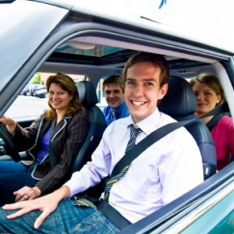
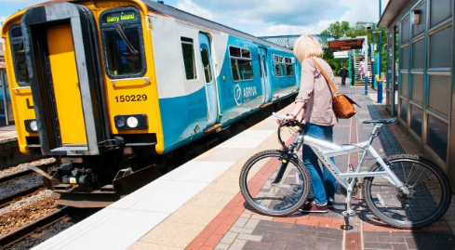
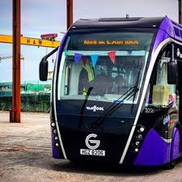
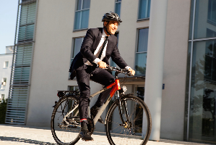
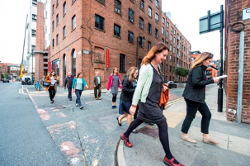
Safe, Sustainable & Active Travel
Safe Travel – no matter what the journey, do it safely!
Sustainable Travel – is about making transport choices.
that do not harm the environment, promote the use of public transport, car share, park & ride, cycling or walking.
Active Travel – encourages us to increase the amount of physical activity we do for all, or part of, any journey.
There are many benefits to choosing more sustainable and active modes of travel!
Notes:
Slide 2 – Safe, Sustainable & Active Travel
The DfI - Safe & Sustainable Travel Division aims to help everyone to connect safely, no matter how they travel and to enable and encourage shifts to more sustainable modes of travel. It promotes, encourages and enables an increased take up of sustainable travel, with the promotion of increased use of Public Transport, Car Share, Park & Ride, Cycling or Walking.
Draft Programme for Government (PfG) - The Northern Ireland Assembly has agreed an outcome measure (No.11) to increase the % of all journeys made by walking, cycling and public transport improving sustainability.
In co-operation with other Departmental / Local Government colleagues, DfI helps to provide the roads and networks for public transport services and promotes moves to more sustainable forms of transport including taking forward the Bicycle Strategy, developing urban bicycle network plans, a plan for greenways, a small grants programme for greenways and the Active School Travel programme.
In addition, it also contributes to the reduction of road casualties. This is done through monitoring and oversight of the Road Safety Strategy to 2020, by developing policies to address poor road user behaviours' and by working with schools and communities to promote road safety.
Benefits of Safe, Sustainable & Active Travel
Walking and cycling for short journeys are easy and convenient ways to build physical activity into our daily routine. The Northern Ireland Public Health Agency recommends that from age 5, children need to do moderate to vigorous intensive activities for at least 60 minutes every day.
Walking & Cycling helps:
Improve health and fitness;
Reduce commuting time;
Protect the environment (by reducing road congestion and pollution);
Reduce car maintenance, fuel and parking costs.
Choosing public transport helps:
Reduce the risk of being involved in a road traffic collision;
Protect the environment (by reducing road congestion and pollution);
Reduce stress and save you time;
Save you money;
Improve health and fitness (when combined with short walks);
Allow you to use travel time for other activities such as reading, catching up with friends, etc.
If you start making some small changes to your normal travel arrangements today you will soon realise some of the many benefits.

Slide 3
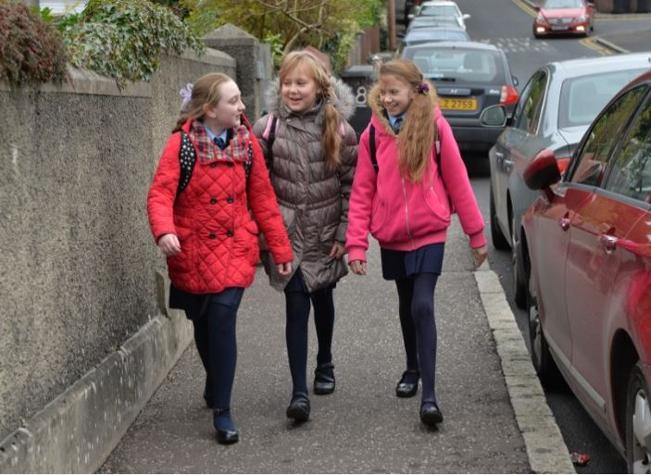
Plan Your Route – Active Travel
How do you travel to school?
Do you always choose the safest route to travel?
Do you always use a safer place to cross?
What are the benefits of walking/cycling to school?
Notes:
Slide 3 – Plan Your Route – Active Travel
By encouraging children to travel to school either by walking or cycling, it will result in less congestion and pollution around the school gates.
Children should be taught if travelling independently to school what route they need to take and to let an adult at home know their plans. Where a zebra/puffin/pelican or other pedestrian crossing is available, the child should know how to use it.
Physical activity will contribute to people’s health and well-being and hopefully lead to living longer, healthier lives.
Experience raises children’s road safety awareness and boosts confidence and decision making skills.
For more information on a range of road safety education issues, visit:
www.nidirect.gov.uk/information-and-services/road-safety-education-resources/road-safety-primary-school-children

Slide 4
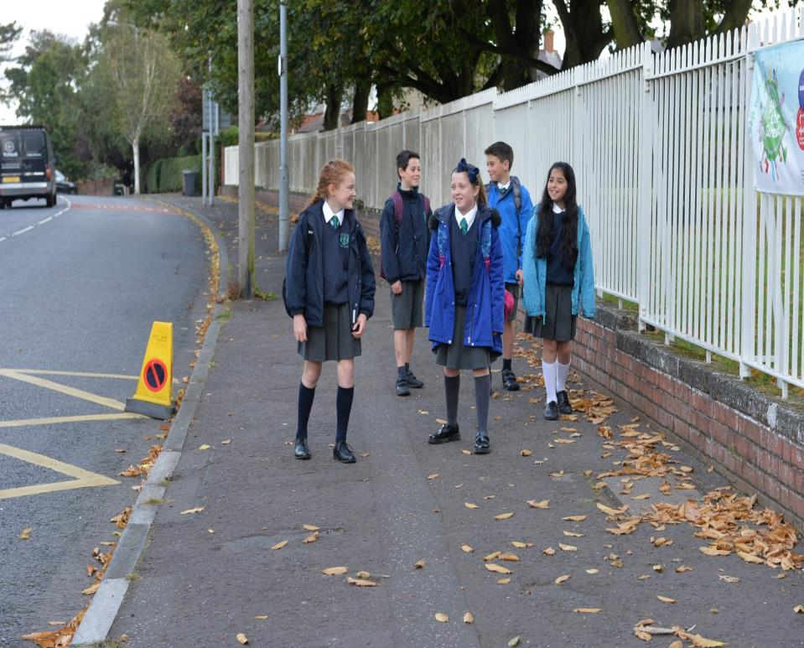
Your Journey to School – Walking
Always use the footpath, where available.
Walk on the inside of the footpath, away from the edge of the road.
If there is no footpath available, walk on the right hand side of the road, facing oncoming traffic.
If you have to cross any road, use the Green Cross Code.
Notes:
Slide 4
Your Journey to School –Walking
As a pedestrian always make sure you walk on the footpath is one is available - if there isn’t a footpath (e.g. rural roads) always walk facing the oncoming traffic so the driver can see you and you can see the driver.
Discuss with your class the differences in town (urban) and country (rural) roads i.e. – footpaths may not always be available on country roads.
Does your class know the Green Cross Code – see the following slides or visit:
www.nidirect.gov.uk/articles/road-safety-7-11-year-olds

Slide 5
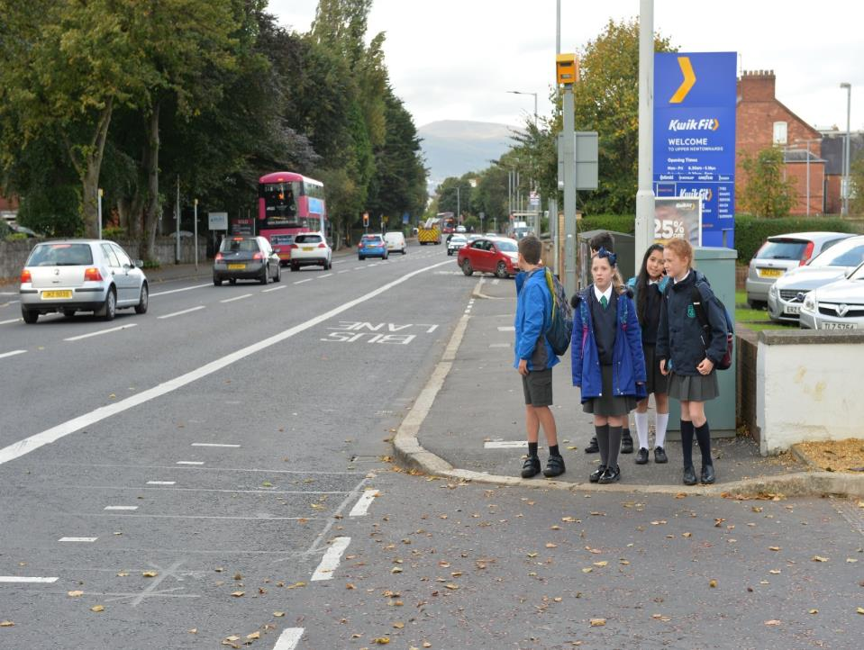
First find a safe place to cross, then STOP.
Stand on the pavement behind the kerb.
Look all around and listen for traffic.
The Green Cross Code
Notes:
Slide 5 – Do you know your Green Cross Code
Reminder of the Green Cross Code - The Green Cross Code itself is a short step-by-step procedure designed to enable pedestrians to cross streets safely.
Find the safest place to cross and then STOP.
Stand on the pavement near the kerb.
Look all around for traffic and listen.
If traffic is coming, let it pass.
When it's safe, walk straight across the road.
Keep looking and listening until you safely reach the other side.

Slide 6
If traffic is coming, let it pass.
When it's safe, walk straight across the road.
6. Keep looking and listening until you safely reach the other side.
The Green Cross Code
Notes:
Slide 6 – Do you know your Green Cross Code
Reminder of the Green Cross Code - The Green Cross Code itself is a short step-by-step procedure designed to enable pedestrians to cross streets safely.

Slide 7
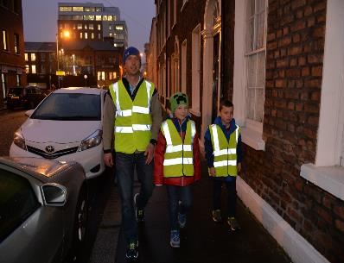
Be Safe, Be Seen
‘Fluorescent by Day, Reflective by Night – the difference brought to light’.
Fluorescent materials (usually yellow, orange or lime green coloured) work best during daytime – but are less effective in the dark.
Reflective materials work best at night – reflecting the light from car and street lights.
Notes:
Slide 7 – Be Safe, Be Seen
Pedestrians
Wear the right clothing at all times: bright or fluorescent during the day, reflective at night. If you haven't got anything reflective, wear or carry something white.
Cross at pedestrian crossings whenever you can. At night, if there is no crossing near, try to cross under a street light.
Carry a torch if you have to walk in an area with no street lights and especially when there are no pavements.
FLUORESCENT BY DAY AND REFLECTIVE BY NIGHT
All pedestrians are more at risk in the dark or bad weather when visibility is poor.
Road collisions often happen when road users cannot see each other until it is too late.
Everyone using the roads is at risk, particularly pedestrians and cyclists.
The problem is worse during autumn and winter because of bad weather and shorter daylight hours.
We can help other road users to see us by wearing the right clothes and accessories.
Fluorescent colours can be seen best during daytime and at dusk, they don't show up at night. Fluorescent materials are usually, yellow, orange or lime green – the majority, including the PSNI, wear yellow.
Reflective materials are best at night - reflecting the light from car and motorbike headlights. They work in the same way as the cat's eyes that mark traffic lanes. Reflective materials are available as stickers, tapes and tags which can be easily attached to clothes and other items.
For best all round protection wear clothes or safety accessories that combine fluorescent colours with reflective material.
Activity:
What reflects light? You will need a torch and some of the following to carry out a class experiment
Mirror
Foil
Matt paper
Glossy paper
Fabric
Plastic
The children can keep a simple tick sheet to keep a record of their findings. Turn off the classroom lights and find out for yourself which one of these items is reflective.

Slide 8
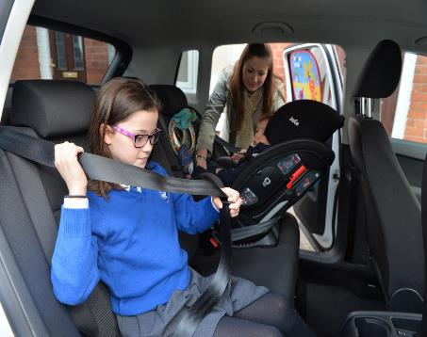
Your Journey to School – Car
As a passenger in a car – always wear a seat belt.
If you are under 135cm tall, make sure you are sitting on the correct child restraint.
Always get in and out of the car on the pavement side (or grass verge).
Don’t distract the driver!
Notes:
Slide 8 - Your Journey to School – Car
Remind the children that they must always wear their seat belt when travelling by car, no matter how short the journey. The seatbelt should be worn across their shoulders and not under the arm.
Children under 135cm in height and under 12 years of age MUST use the appropriate child restraint. For more information, go to:
https://www.nidirect.gov.uk/articles/child-car-seats-restraints-and-seatbelts
It is safer to enter and exit a vehicle on the pavement side (or grass verge).
Extra care MUST always be taken around buses particularly when getting on and off the bus, always ensure that the bus has moved off before attempting to cross the road.

Slide 9
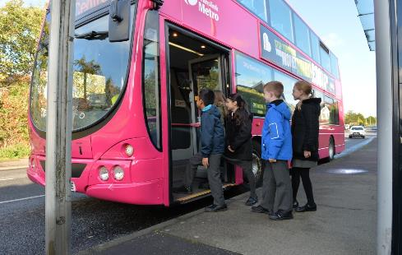
Your Journey to School – Bus
Before the bus arrives, wait in line.
When the bus stops and the door opens, don’t push those in front of you.
Store bags and equipment safely.
Sit down on a seat and if a seat belt is available, put it on.
Notes:
Slide 9 - Your Journey to School – Car
Children should be taught how to stand in an orderly line and wait patiently until the bus arrives. Why not role-play this in the school grounds.
Once the bus arrive and the door is open, children should wait their turn to enter and NEVER push those in front.
School bags, sports and other equipment such as musical instruments should be stored safely and securely under seats or the overhead racks.
Remind the children that they must always wear their seat belt, if available, when travelling by bus, no matter how short the journey. The seatbelt should be worn across their shoulders and not under the arm.

Slide 10
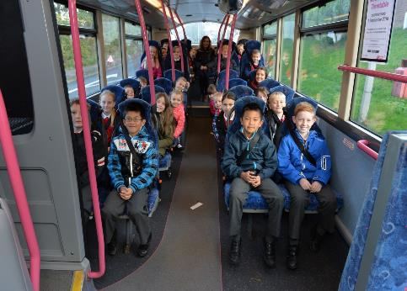
Your Journey to School – Bus
Never distract the driver!
Wait until the bus stops before leaving your seat to exit the bus.
Do not start to cross the road until the bus has moved away and you can see clearly in both (or all) directions.
Notes:
Slide 10 - Your Journey to School – Bus
Impress upon pupils how important the bus drivers job is (i.e. to get everyone safely to their destination) and therefore, do not distract him/her by bad behaviour (shouting/fighting/throwing objects around the bus).
Bus passengers should stay in their seat until the bus has stopped, before attempting to get out of their seat.
Children should be reminded that after exiting the bus, they should NEVER cross the road in front of, or behind, the bus. Instead stand on the footpath (or grass verge) and allow the bus to move away. Make sure you can see clearly in both (or all) directions and it is safe, before attempting to cross.

Slide 11
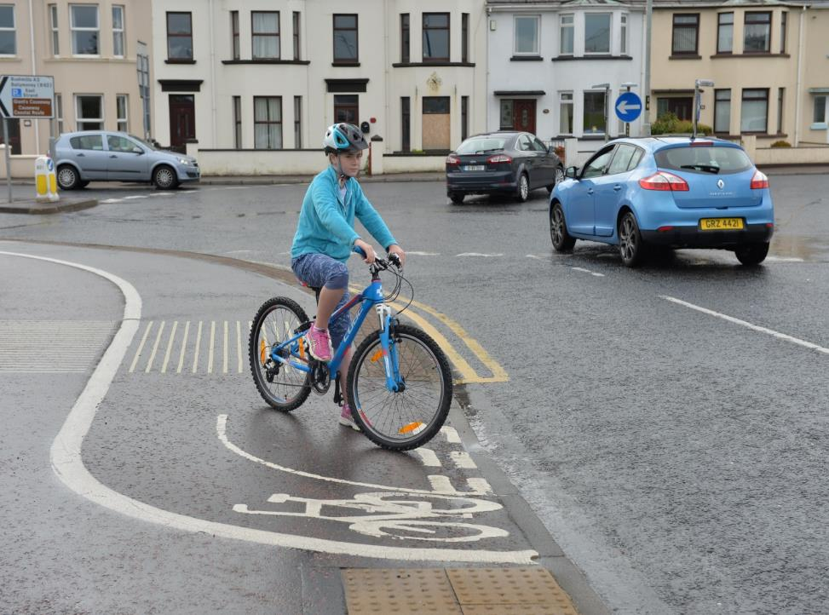
Your Journey to School – Bicycle
Learn how to cycle safely.
Cycling is a great way to get around and keep fit.
Keep safe and remember to use the Green Cross Code to cross roads.
Always wear a helmet and hi-visibility clothing.
Notes:
Slide 11 - Cycle Safely
Children should be encouraged to cycle as it is a good way to get around and stay fit. Wearing a properly fitted helmet and hi-visibility clothing should be encouraged from an early age. Lots of schools offer Cycling Proficiency training to their pupils - for further information see: www.nidirect.gov.uk/articles/cycling-proficiency-scheme
Although some children at primary school may not be cycling independently, infrastructure is changing to promote cycling and children should be made aware of how the roads are changing to take account of cyclists.

Slide 12
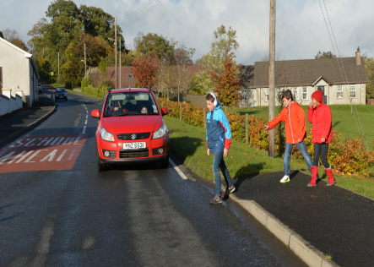
Don’t Get Distracted!
Stay alert when on or near the road, especially as a pedestrian.
Do not let anyone, or anything distract you and remain alert at all times.
Avoid using a mobile phone when crossing the road.
Do not wear ear/headphones so you can hear vehicles.
Remember the Green Cross Code!
Notes:
Slide 12 - Don’t Get Distracted!
Most people use or own a mobile device to interact with friends, play games or listen to music. However, when we are using them they engage our concentration and focus, to the extent that we may not be fully aware of other things going on around us.
When using the road we are in a potentially hazardous situation, especially if our attention is distracted and we don’t give our full attention to what is happening around traffic.
To ensure we use the road safely we need to:
Avoid using a mobile phone or, if listening to music, remove your ear/headphones so you can hear vehicles.
Look out for approaching emergency vehicles and concentrate on crossing the road.
Follow the rules of the road and remember to use the Green Cross Code.
More than 55 young people a week are killed or seriously injured in the UK because they were listening to earphones instead of listening for cars!
Posters which are free to schools are available on this theme from the Think website http://think.direct.gov.uk/roadsafety.html

Slide 13
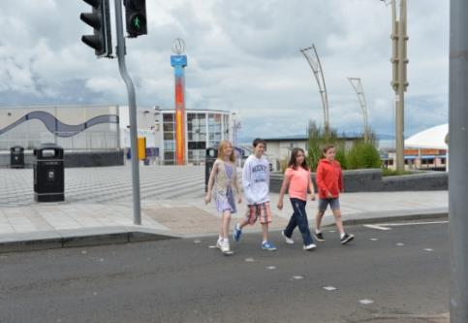
Remember…
Keep yourself and others safe by practising good road safety habits.
Use the Green Cross Code.
Wearing something bright, fluorescent (by day) and reflective (by night).
Always wear your seat belt when travelling in the car.
Notes:
Slide 13 - Summary – Remember to Keep Safe on the Road
Teachers should remind pupils of the key messages in this presentation.

Slide 14
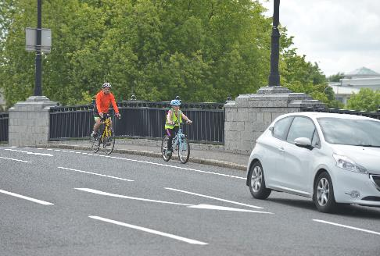
Remember…
Always wear a properly fitted helmet when riding your bicycle.
Always expect the unexpected.
Never take risks as a pedestrian, passenger, or cyclist.
Notes:
Slide 14 - Summary – Remember to Keep Safe on the Road
Teachers should remind pupils of the key messages in this presentation.

Slide 15
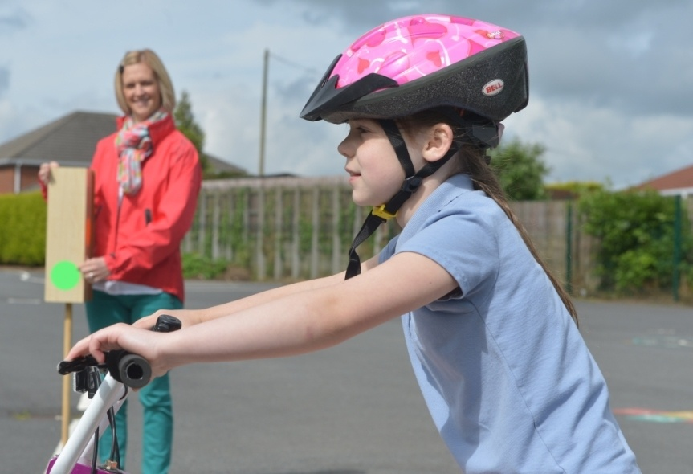
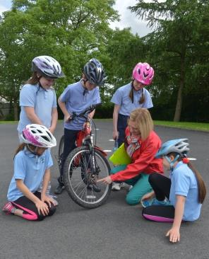
ANY QUESTIONS?
Notes:
Slide 15 - Questions
Provide the opportunity for children to ask questions at the end of the presentation and / or give them something to think about (or do) to reinforce the learning of the session. This could take the form of different types of activity or role-play exercises:
- practise the six steps of the Green Cross Code;
- proper procedure for using the School Crossing Patrol;
- measuring everyone’s height to find out who is under 135cm and therefore needs to use an appropriate child restraint;
- experiments such as using various materials to protect an egg (polystyrene, cellotape, cardboard) and then drop from shoulder height to show how a cycle helmet can protect a cyclist’s head if they were to fall off their bicycle;
- plan the safest way from school to the park (is the shortest way the safest way?)
For more information and/or advice on road safety and sustainable travel, Telephone: 030 0200 7838 and ask for ‘road safety’ or email: safeandsustainabletravel@infrastructure-ni.gov.uk

