Slide 1
Highway Code for Road Users
Notes:
Knowing and applying the rules contained in The Highway Code could significantly reduce road casualties.
Cutting the number of deaths and injuries that occur on our roads is a responsibility we all share.
The Highway Code could keep you out of prison and save you from killing others or being killed whether you are a driver, a motorcyclist, a cyclist, a pedestrian or any other type of road user
The aim of this module is to familiarise pupils with the contents of The Highway Code relating to every type of road user.
Students should:
Understand why a code of practice for road users is both necessary and desirable;
Know the different types of road sign and have a working knowledge of what they mean;
Realise the consequences of not obeying the rules of The Highway Code.

Slide 2
Pre-Evaluation – Highway Code
 | Strongly Agree | Agree | Don't Mind | Disagree | Strongly Disagree
I have recently read the Highway Code
Pedestrians and cyclists do not need to read the Highway Code
Knowledge of the Highway Code is essential to safe driving
I know the meaning of most road signs
The Highway Code is an important part of the Driving Test
Notes:
Teachers should complete the pre-evaluation before watching the video. This is located at Annex A in the teaching notes.
Please complete by asking your class the questions- this could be answered by a show of hands. Please tick one answer box per question.
If teachers could complete a hard copy of this and then return to Road Safety Promotion and Outreach Branch, Room G-31, Clarence Court, 10-18 Adelaide Street, Belfast, BT2 8GB or email to safeandsustainabletravel@infrastructure-ni.gov.uk

Slide 3
Video
Just Because
Notes:
Play DVD – The Highway Code.
Before you show the advert, tell students that they have to think about what each driver is doing wrong and how it does not comply with the Highway Code?
Please note that all the details re penalty points can be found on pages 124-127 of ‘The Highway Code’.

Slide 4
Discussion Points
How did the penalties differ depending on what each driver was doing?
Are penalty points an effective way to enforce the rules?
Examine how penalty points affect a new driver differently from a more experienced driver .
Notes:
How did the penalties differ depending on what each driver was doing;
No seatbelt – 3 penalty points;
Mobile phones – 6 penalty points and £200 fine;
Speeding – 3/6 penalty points;
Careless cycling – up to £1,000 fine
Discuss if penalty points is an effective way to enforce the rules;
Inconsiderate or careless drivers/motorcyclists care taken off the road. If a driver/motorcyclists accumulates 12 or more penalty points within a 3 year period must be disqualified.
Examine how penalty points affect a new driver differently from a more experienced driver;
Special rules apply to new drivers who have been driving for less than two years. Once a new driver accumulates six or more penalty points within the initial two period their licence will automatically be revoked.
Please note that all the details re penalty points can be found on pages 124-127 of ‘The Highway Code’.

Slide 5
Discussion Points
What rules did you follow this morning on your way to school?
What helps keep order on the road?
Give some reasons why you should know the rules of the Highway Code
Notes:
Possible answers include -
Got dressed; wore seatbelts in car or in bus (where available); driver/cyclists use the left side of the road; be in school on time; walk don’t run in corridors; go to the classes as shown in the timetable; don't talk back to teachers etc.
Since 1931 The Highway Code has been the official guide to using the roads safely and legally. It has contributed greatly to road safety and reliable road transport. Every driver must have a working knowledge of The Highway Code and this forms part of the UK driving test.
The Highway Code contains many rules that are legal requirements and if you disobey them you are committing a criminal offence. It contains rules which apply to all road users – cyclists, pedestrians and drivers.
If you wish to obtain a driving licence you will be tested on your knowledge of The Highway Code.

Slide 6
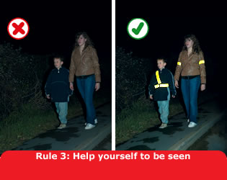
The Main Rules that Relate to a Pedestrian
Dress to be seen
Green Cross Code
Safe Places to Cross
Traffic Calming
Notes:
Dress to be seen:
High-visibility clothing is clothing made of fluorescent material with an added reflective tape or shapes. This clothing is useful both during the day (fluorescent) and at night (reflective). During the day the sun's ultraviolet rays react with the fluorescent colours to make them appear to ‘glow’ increasing daytime visibility. The effect is stronger in poor light conditions such as in fog or towards dusk.
At night, light from sources such as car headlights bounces off the reflective areas to make the tape glow, increasing night time visibility. Some reflective materials are retro-reflective which means the light bounces back to its source. If a car shines it’s headlights on retro-reflective material, most of the light is reflected back to the driver. Other reflective materials are made using glass bead technology which scatters the light, some of it getting reflected back to the driver. High visibility products can include either type. See Rule 3 of the Highway Code.
The main thing to remember - to be seen during the day, at dusk and at night you need something that is fluorescent and reflective.
Green Cross Code:
Ask the pupils if they can repeat each of the five rules of the Green Cross Code. It elaborates on the basic Stop, Look and Listen principles taught to young children.
Rule: 1. First, find a safe place to cross. For all five rules see general Teacher’s Notes, Rule 7 of The Highway Code and Task sheet 3. Ask pupils where it would not be safe to cross – bend, either side of a hill or between parked cars.
Safe places to cross:
Stress that safer places to cross may not be completely safe and that they should still adhere to the basic rules of the Green Cross Code. Safer places include pelican crossings, puffin crossing, zebra crossings, subways and footbridges.
Traffic calming:
Going too fast is one of the main causes of car crashes. When residents are concerned about the safety of where they live, it is usually because they feel that drivers are speeding. Pedestrians should be safer in areas where traffic calming operates. Traffic calming includes road humps, speed tables, speed cushions, build outs, chicanes, pinch points, central refuge/traffic islands , variable speed signs and speed cameras.

Slide 7
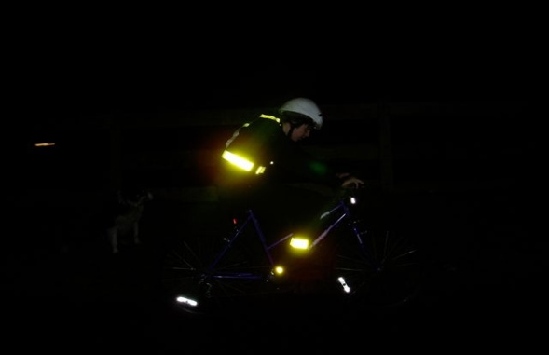
The Main Rules that Relate to a Cyclist
Dress to be seen
Use of Cycle Routes
Safe Places to Cross
Helmets
Notes:
Dress to be seen:
Light coloured or fluorescent clothing helps other road users see you in the daytime or in poor light and reflective clothing so you can be seen in the dark. Rule 59. Avoid clothes that may get tangled in the chain, in the wheel or that may obscure your lights.
Your bicycle too must have accessories that help it be seen. Bicycles must have front white lights and a rear red light for night riding . All bicycles must have a red rear reflector fitted and amber pedal reflectors. For information a bell and working brakes are also required by law (see rule 60 and page 118 of The Highway Code).
Cycle routes:
Where available cyclists should use cycle routes.
These are indicated by a sign with a white bicycle on a blue background.
Cycle tracks are also available for use by cyclists. These are usually located away
from the road and are sometimes shared by pedestrians. Each lane may be indicated
by a white line and cyclists must adhere to this segregation and give due care and
attention when passing pedestrians. The sign for the cycle track has a blue
background with a cycle separated from a pedestrian by a white line.
Safer places to cross:
A toucan crossing is the only light-controlled crossing which allows cyclists to ride across the road while sharing the space with pedestrians. If using other crossings such as a zebra crossing the cyclist should dismount to cross.
Helmets:
Cyclists should wear an appropriately fitted helmet which confirms to current regulations. This is shown by the EN1078 European standard or the higher Snell B-90 standard.
Medical research shows that bicycle helmets can prevent up to 85% of cyclists' head injuries.

Slide 8
Post Evaluation – Highway Code
 | Strongly Agree | Agree | Don't Mind | Disagree | Strongly Disagree
I have recently read the Highway Code
Pedestrians and cyclists do not need to read the Highway Code
Knowledge of the Highway Code is essential to safe driving
I know the meaning of most road signs
The Highway Code is an important part of the Driving Test
I am more aware of the contents of the Highway Code
Notes:
Teachers should complete the pre-evaluation before watching the video. This is located at Annex A in the teaching notes.
Please complete by asking your class the questions- this could be answered by a show of hands. Please tick one answer box per question.
If teachers could complete a hard copy of this and then return to Road Safety Promotion and Outreach Branch, Room G-31, Clarence Court, 10-18 Adelaide Street, Belfast, BT2 8GB or email to safeandsustainabletravel@infrastructure-ni.gov.uk

