Slide 1

Drink and Drugs Road Safety Presentation
Notes:
Slide 1
This presentation was created by DFI Road Safety Education Officer Service. The purpose of this presentation is to educate young people about the dangers that drinking and drugs pose to their own and others’ road safety.
This presentation is intended for children in years 12, 13 and 14. It is recognised that the majority of children will not be driving or indeed drinking, but the issues can be discussed in a hypothetical or preventative way.
In 2015, 74 people were killed and 711 people were seriously injured on Northern Ireland’s roads.
The vision from Northern Ireland Road Safety Strategy to 2020, Driving Road Safety Forward is: “To make a journey on Northern Ireland’s roads as safe for all road users as anywhere in the world.” The Strategy was developed and produced by DFI. However, the action measures contained within the strategy cannot be achieved by the actions of DFI alone and will be delivered by DOE’s road safety partners. These include The Police Service of Northern Ireland, Northern Ireland Fire and Rescue Service, Northern Ireland Ambulance Service and Department of Education.

Slide 2

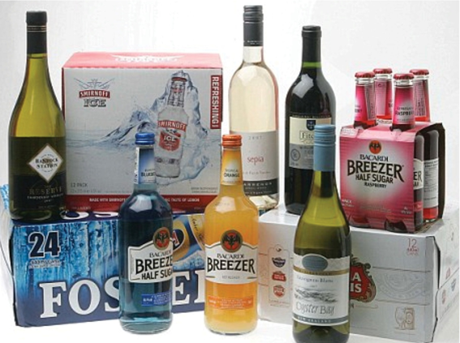
All these drinks contain alcohol
Never Ever Drink and Drive!
Notes:
Slide 2
NEVER, EVER DRINK AND DRIVE
Please use this opportunity to reinforce the message that it is no longer socially acceptable to drink and drive. Drinking and driving is universally considered one of the most shameful behaviours someone can engage in.
Between 1998 and 2010 almost 1 in every 5 road deaths in NI were caused by drivers who had been either drinking or taking drugs. – this is the same for 2002-2015, however might be best to use the most recent 10 year period - Between 2006 and 2015 almost 1 in every 6 road deaths in NI were caused by drivers who had been either drinking or taking drugs
Discuss current attitudes towards drinking such as binge drinking. It is worth mentioning the peer pressure felt by young people to drink. Also it may be appropriate to discuss the attitudes of families to drink and how we as a society encourage drinking to mark birthdays, weddings and funerals. Drinking is often considered a rite of passage that young people must go through.

Slide 3
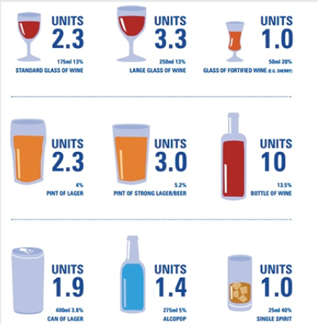
Alcohol is measured in units
Remember: One drink is not always one unit of alcohol
Notes:
Slide 3
Discussion point - Is there a safe limit to drink and drive?
Open the topic to the audience – if there’s no response suggest 4 pints, 6 pints to get a discussion started.
All studies have shown that even after one alcoholic drink people’s reaction times, ability to cope with real time issues and assessment of risk are very much diminished.
THERE IS NO SAFE LIMIT – ONE DRINK IS ONE TOO MANY
You may want to remind students of the TV campaigns which warn against Drink Driving:
‘Shame’ – Little boy playing football in his back garden when a driver who had been drinking crashed and the car came through the fence and killed him. The strap line is ‘Could You Live with the Shame’ Never, Ever Drink and Drive.
‘Just One’ – Attractive girl meets boy at a bar, he is clearly driving that evening but orders a pint of lager. The girl looks at him showing her disapproval and he then thinks about all the consequences that could happen if he has just one drink and then drives his car. He decides not to have the alcoholic drink and the girl clearly approves of his decision. Strap line is ‘Just One Drink Impairs Driving’ Never, Ever Drink and Drive.
‘Hit Home’ – Campaign showing a pint of lager which slowly empties. Each time there is a voice over saying “Every drink increases your risk of Crashing”. Eventually the pint glass explodes representing a crash and the strap line is ‘Hit Home Yet?’ Never, Ever Drink and Drive.
The clear message in all these campaigns is that there is no safe limit for drinking alcohol when driving. The message should always be ‘Never Ever Drink and Drive’
All alcoholic drinks are measured in units.
How often have you watched TV and seen someone in say a soap go up to the bar and ask for a unit of alcohol? (No, you don’t) They ask for a pint of beer or a vodka and coke.
Are you aware how many units are in the drink ordered?
Do you know that different drinks have different strengths?
Some examples of different alcoholic drinks:
Regular pint of beer/cider = 2.2 units
Alcopop or can of lager = 1.5 units
Glass of wine 250mls = 3 units
Single measure of spirits 25mls = 1 unit
Bottle of wine = 9 units
Unfortunately it’s not as simple as saying you can have X amount to drink and you’ll definitely be within the legal limit. The way your body processes alcohol is affected by many things such as your size and weight, your gender, how much sleep you’ve had and even how stressed you are. This is why it’s easy to accidentally go over the legal limit.
SIMPLE ANSWER - BEST AVOID ALCOHOL ALTOGETHER IF YOU ARE DRIVING

Slide 4
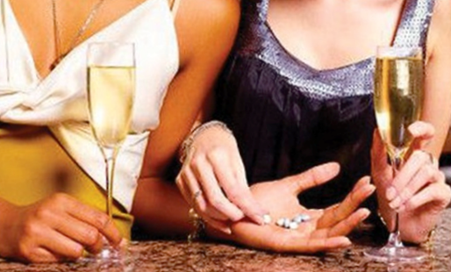
Alcohol and drugs
It impairs the brain
Affects your judgement
Takes effect quickly
Wears off slowly
Notes:
Slide 4
ALCOHOL AND DRUGS
This slide looks at how alcohol and drugs impairs the brain and affects your judgement.
Teachers should engage with their audience as to how alcohol and drugs will affect their personality, judgement, reaction times and perception of risk.
How do alcohol and drugs affect you?
If you get no response from your students you may make a few suggestions.
Do you feel happy?
Does it change your mood?
Do you feel depressed or anxious?
From the second you take your first sip, alcohol starts affecting your body and mind. After one or two drinks you may start feeling more sociable, but drink too much and basic human functions, such as walking and talking become much harder. Contrary to what many people believe alcohol is not a stimulant. It is a depressant. This is why drinking too much often leads to impaired judgement, slurring of the speech, tendency to change behaviour and loss of short term memory.
On the road, alcohol is one of the leading causes of collisions, leading to many injuries and deaths. It could be because a driver has had an alcoholic drink or it could be a pedestrian who has had an alcoholic drink and their thinking process is impaired and they put themselves and other road users at risk.
Because alcohol is a depressant, it slows down the brain and affects the body’s responses.
Drinking alcohol:
affects our judgement and reasoning
slows down our reactions
upsets our sense of balance and coordination
impairs our vision and hearing
makes us lose concentration
makes us drowsy
People who have been drinking are more likely to take risks, further increasing the likelihood of accidents and collisions.
Would you take the risk?
Is it worth it?
Remember alcohol takes effect quickly BUT wears off slowly
DRINKING AND DRIVING DOESN’T MIX

Slide 5
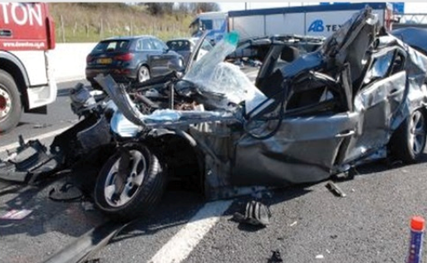
Alcohol and driving
There is NO safe limit
At the legal limit a driver is six times more likely to have a collision
Drivers can still be under the influence the morning after the night before
Notes:
Slide 5
ALCOHOL AND DRIVING
This slide gives the teacher the opportunity to discuss limits - Is there a safe limit?
You can make the audience aware that a driver may be over the legal limit the morning after the night before. (Covered in more detail on slides 7 and 8).
Discussion – even at the legal limit a driver is 6 times more likely to have a collision.
Again reiterate that not everyone is the same, one person could consume x amount of units and be within the legal limit while another could have the same amount but be over the legal limit.
Things that should be discussed:
Would you drink and drive?
Do you know anyone who does and would you travel in a car with them?
Are you aware that if you are involved in a collision the driver will be breathalysed even if they are not at fault.
WHY TAKE THE RISK IN HAVING ANY – ONE DRINK IS ONE TOO MANY – NEVER EVER DRINK AND DRIVE

Slide 6
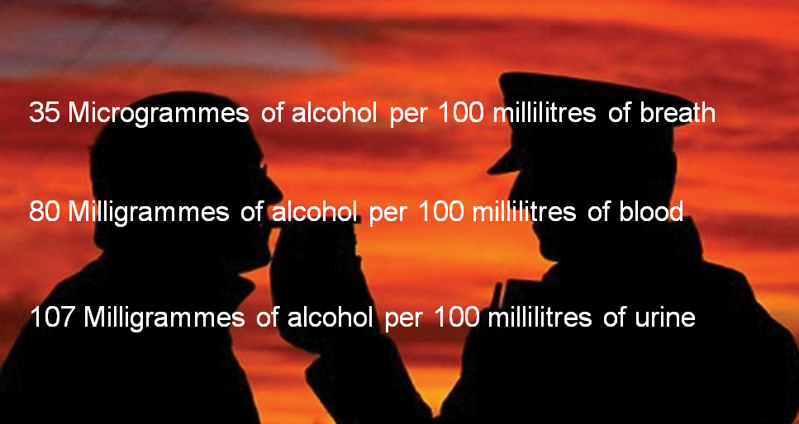
Legal limits for driving
Notes:
Slide 6
LEGAL LIMITS FOR DRIVING
At present the legal alcohol limit for drivers in Northern Ireland and GB is:
35 micrograms of alcohol per 100 millilitres of breath
80 milligrams of alcohol in 100 millilitres of blood
107 micrograms of alcohol per 100 millilitres of urine
Teachers should be aware of the impending changes to legislation which will soon go before the NI Assembly reducing the amounts of alcohol in blood stream before arrests to 50mg. There is also a proposal to have a lower limit of 20mg for vocational and novice drivers (those who have just past their driving test and required to display plates to that effect). People who drive for a living will face stricter penalties due to the responsibilities they have to other road users.
Later in the presentation you will see how long alcohol stays in your system and the risk you take when you decide to drive after a night of drinking.
What happens if you are caught driving over the legal limit? If you’re convicted of drink driving you’ll be banned from driving for at least 12 months and fined. You could even face a prison sentence.
It is also illegal to be in charge of a vehicle if you’re over the legal limit. For example, you could be prosecuted if you’re over the limit and you sleep in your car and have the keys with you or you supervise another driver who only has a provisional licence.
The maximum penalty for being in charge of a vehicle and over the limit is 3 months in prison, a fine and a possible driving ban.
You will have a criminal conviction which may affect your future employment

Slide 7
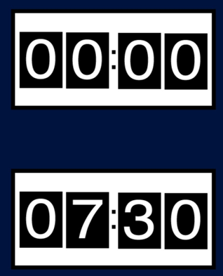
Alcohol takes effect quickly but wears off slowly
Getting rid of the alcohol
Midnight
At midnight, after an evening’s drinking, a driver may for example have consumed 8 pints of standard beer (approx 20 units) into their system. More if premium or strong beer.
07:30am
On getting up, there could be up to 130mg still in your system. Therefore, a driver is unfit to drive.
Notes:
Slides 7 and 8
ALCOHOL TAKES EFFECT QUICKLY BUT WEARS OFF SLOWLY
Teachers should use these slides to indicate the amount of time that it takes the body to eliminate alcohol.
The student may be given the opportunity to work out the time it takes the body to eliminate alcohol from their first drink to what would be a safe time to drive.
Slides are self explanatory.
Again bear in mind that everyone is different and some people will take longer than others for the alcohol to leave their system. Prescription drugs can also cause adverse effects when mixed with alcohol.
Teacher needs to emphasise that no amount of coffee, cold showers or greasy food will speed up alcohol elimination. It just takes time.
Teachers again should emphasise that the timings are a guideline only.
THE ONLY SAFE COURSE IS NOT TO DRINK AND DRIVE

Slide 8
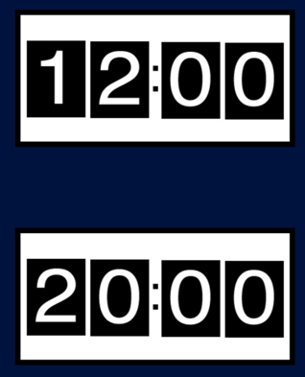
Alcohol takes effect quickly but wears off slowly
Midday
By lunchtime, elimination has continued to around 80mg. You could be over the legal limit.
20:00pm
All the alcohol is not eliminated until around 8pm, 20 hours after it was consumed. It is impossible to speed up alcohol elimination. Neither a shower, nor a cup of coffee, or other ways of “sobering up” will help. It just takes time.
Notes:
Slides 7 and 8
ALCOHOL TAKES EFFECT QUICKLY BUT WEARS OFF SLOWLY
Teachers should use these slides to indicate the amount of time that it takes the body to eliminate alcohol.
The student may be given the opportunity to work out the time it takes the body to eliminate alcohol from their first drink to what would be a safe time to drive.
Slides are self explanatory.
Again bear in mind that everyone is different and some people will take longer than others for the alcohol to leave their system. Prescription drugs can also cause adverse effects when mixed with alcohol.
Teacher needs to emphasise that no amount of coffee, cold showers or greasy food will speed up alcohol elimination. It just takes time.
Teachers again should emphasise that the timings are a guideline only.
THE ONLY SAFE COURSE IS NOT TO DRINK AND DRIVE

Slide 9
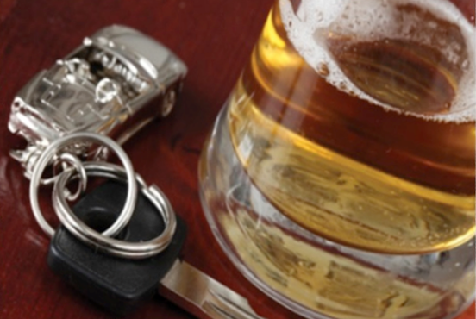
After the first drink
Judgement impaired
Risk taking increased
Vision impaired (peripheral vision)
Think time increased
Reactions slower
Notes:
Slide 9
AFTER THE FIRST DRINK
The teacher should discuss with the students how their reactions, judgements and thinking time will be compromised after the first drink.
Any amount of alcohol affects your driving performance. Even after one drink you will:
Be less alert and careful, however slowly you drive.
Have trouble judging your speed.
Be slower to react to hazards and it will take you longer to stop.
Not be aware of your actions.
The teacher should discuss with students how alcohol affects them even after one drink.
SO IT’S ALWAYS BEST TO AVOID ANY ALCOHOL IF YOUR ARE DRIVING

Slide 10
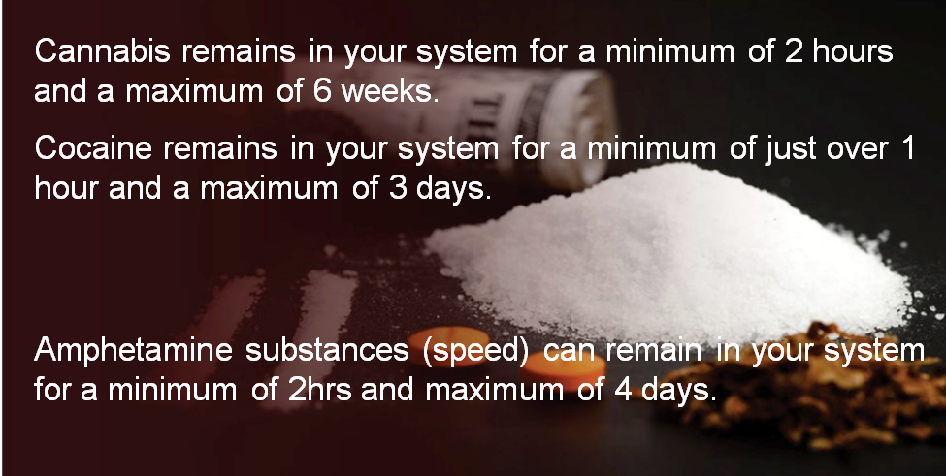
Illegal Drugs
Notes:
Slide 10
ILLEGAL DRUGS
Teachers may find the following website useful for up-to-date information on drugs awareness www.frank.com/drugs
The slide shows how long drugs remain in your system. Taking drugs can put you at greater risk on the road as a pedestrian, driver or passenger. Drugs can change your awareness of risk and make you behave dangerously putting yourself and others at risk of injury and death.
Drugs can be broadly divided into three categories based on their main effects:
They may act as stimulants, depressants or hallucinogens. Quite a few drugs show two of these effects at the same time.
Stimulants make you feel like you have lots of energy and confidence. They include cocaine, speed, ecstasy, and mephedrone.
Depressants make you feel relaxed and chilled out. They include alcohol, tranquillisers, heroin and cannabis.
Hallucinogens can make you view reality in distorted way and sometimes cause vivid hallucinations. They include LSD and magic mushrooms.
In addition to these 3 broad categories, each particular drug has its own specific effects and risks. When you obtain drugs anywhere other than from a reliable pharmacy, it can be difficult to say exactly what effects and risks the drug may have. A drug may be quite new and its harms may not yet be fully known, or the drug you are actually taking may not be what you believe it to be (eg both PMA and mephedrone have been sold as MDMA/ecstasy). Information on the known effects of each drug is available in the A-Z of drugs. (Sourced from www.frank.com).
Teachers may want to discuss at this point the importance of never leaving your drink unattended as it may be spiked with some of the above drugs.
NEVER TAKE DRUGS AND DRIVE
You may wish to ask students if they have seen the DOE Anti Drug Driving road safety campaign.
The ‘Steps’ campaign aims to raise public awareness of the drug driving problem and highlight the ultimate consequences of driving when under the influence of drugs.
The advertisement starts with a close up of an eye and the camera slowly pans out to show a young man lying in a hospital bed and shows the stark reality of the consequences of drug driving. It portrays the desolation and despair felt by the victim as he faces up to a bleak future confined to a hospital bed.
The message firmly lays responsibility for driving impaired through drugs at the driver. It is not about ‘getting away’ with it and ‘not getting caught’. It is about taking responsibility for your actions behind the wheel and not putting your life, or that of any road user, in danger. The campaign also speaks to passengers, empowering them to take responsibility for their own safety by not allowing themselves to be driven by a drug driver.
The campaign carries the strap line ‘What Steps Will You Take to Stop a Drug Driver From Wrecking Your Life?’

Slide 11
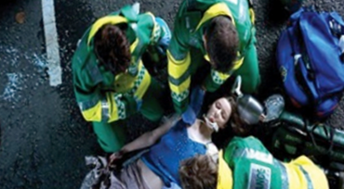
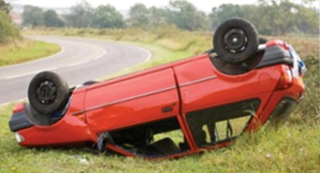
Your actions affect all road users
Think about your attitude and behaviour as a driver or passenger
3,196* people detected drink/drug driving from January 2011 to June 2011
56,633* people detected for excess speed in the same period
How selfish can you get?
*Source PSNI – please note these figures are provisional and subject to change
Notes:
Slide 11
YOUR ACTIONS AFFECT ALL OTHER ROAD USERS
This slide looks at the detection rates for drink/drug driving in Northern Ireland and the numbers detected for speeding.
Alcohol and driving remains a problem in Northern Ireland as the statistics show. It is no longer socially acceptable to drink and drive. Much progress has been made over the years, including the use of high profile advertising campaigns to raise awareness of the consequences. However, people still continue to drink and drive and often they pay the price through injury or death. The lucky ones get stopped by the Police.
Slide 7 dealt with the consequences of getting stopped for driving while under the influence. To remind you:
If you’re convicted of drink driving you’ll be banned from driving for at least 12 months and fined. You could even face a prison sentence.
Speed is another problem we have on the roads of Northern Ireland:
56,633 people were detected for excess speed in 2013
Speed remains one of the biggest causes of death and serious injury on our roads.
if a pedestrian is hit by a car travelling at 20mph, 90% will survive.
if a pedestrian is hit by a car travelling at 30mph, 50% will survive.
if a pedestrian is hit by a car travelling at 40mph, 10% will survive.
Teacher should use this opportunity to discuss with their students how their attitude and behaviour as a driver or passenger impacts on others.
Is it acceptable to drink and drive?
Would you drink and drive?
Would you travel with someone who has been drinking?
Is it ok to speed – even 10 mph over the limit?
KEEP TO THE SPEED LIMITS – DO NOT DRINK AND DRIVE

Slide 12
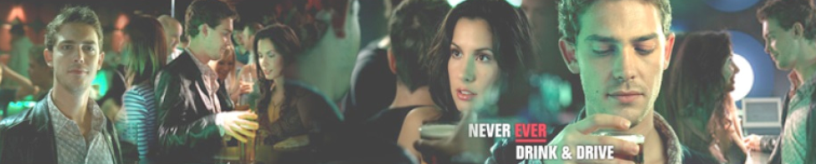
Who are the chief offenders?
Men
Women
Responsible for 90% of alcohol related collisions
Increasingly more women are being detected for drink driving
18-24 year old males are responsible for 2 out of 3 alcohol related collisions
Notes:
Slide 12
WHO ARE THE CHIEF OFFENDERS?
The teacher should discuss with the students why statistics show that males are the chief offenders.
Teacher should emphasise that more women are being detected for drink driving.
Expect a healthy debate from males in particular that they are not always at fault. Teacher will rely on proven statistics at this point.
Age group most at risk - 17-24 year olds
Drivers aged between 17 and 24 account for around 10% of our licensed drivers, yet were responsible for 35% of the 191 fatal collisions between 2011 and 2015 and 28% of the 2,076 fatal and serious collisions which where a car or light goods vehicle was deemed responsible (source PSNI).
When we examine the driver behaviours which caused the fatal and serious collisions for which 17-24 year olds were responsible they are similar to those detailed above for all driver collisions.
Mention should be made of higher insurance premiums for young adults. Is this fair? – discuss.
Should there be a curfew scheme, a rule not to carry passengers, driving monitors installed in vehicles?

Slide 13
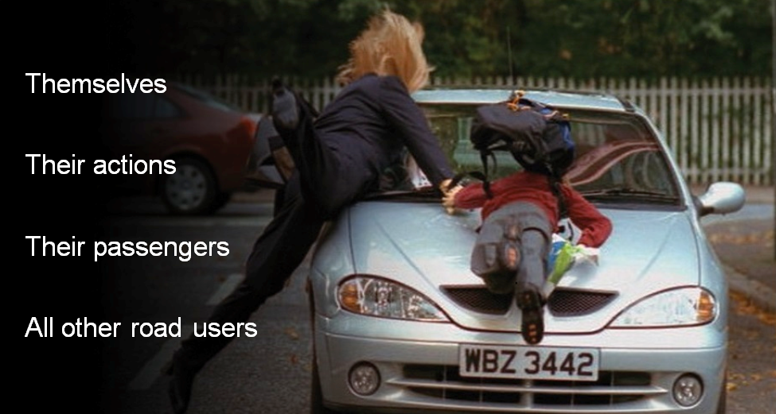
Drivers are responsible for:
Notes:
Slide 13
DRIVERS ARE RESPONSIBLE FOR ... ?
Teachers should use this slide to discuss with their students how they are responsible for:
Themselves
Their Actions
Their Passengers
All Other Road Users
A discussion should take place where the students talk about how their driving (either now or when they are learning / pass the test) impacts on themselves and others.
Would you drink and drive?
Would you speed?
Would you insist that your passenger wear their seatbelt?
What would you do if they refused to wear their seatbelt?
Discuss how safe is a drunk pedestrian?
Would you buy your friend an alcoholic drink if you knew he was driving?
Would you get into the car if you know the driver had been drinking alcohol or had taken drugs?
How do you feel about someone who drinks and drives?
REMEMBER YOUR RESPONSIBILITIES WHEN USING THE ROADS, YOU CANNOT RELY ON OTHERS TO ENSURE YOUR SAFETY

Slide 14
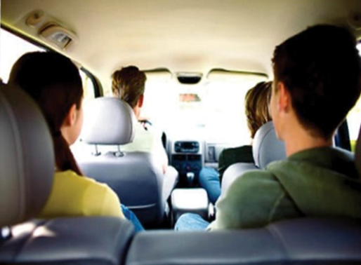
Passengers’ responsibilities
Do not travel with a driver under the influence of drink / drugs
Ensure only soft drinks are consumed by the driver
Don’t distract the driver
Encourage safe driving
Notes:
Slides 14 and 15
PASSENGERS’ RESPONSIBILITIES
Teachers could use these slides to discuss with their students the definition of a good passenger.
Things to be discussed:
NEVER travel with a driver who has taken drink/drugs
Don’t distract the driver
Encourage safe driving
Questions you might ask regarding negative behaviour:
On a night out would you take a lift home with someone who you know to have taken alcohol or drugs? What would you do? - Discuss.
When travelling as a passenger, are you aware that your behaviour may distract the driver?
Examples may be showing the driver a text on your mobile phone. Shouting out of the window at pedestrians.
The audience will provide many examples of distractions.
Would you say anything to the driver if he/she used their mobile whilst driving? Discuss
Would you comment on the driver’s speed if you think they are going too fast? Discuss
Would you encourage everyone in the car to wear their seatbelts? Discuss
Would you consider loud music to be a distraction? Discuss
Messing around in the car, example play fighting, punching the driver in the arm, covering his eyes from behind. Discuss
Examples of good passenger behaviour:
Always wear your seatbelt and encourage others to wear theirs.
Never travel with a driver under the influence of drink/drugs.
Don’t distract the driver.
Encourage safe driving.
DISTRACTING THE DRIVER COULD HAVE FATAL CONSEQUENCES

Slide 15
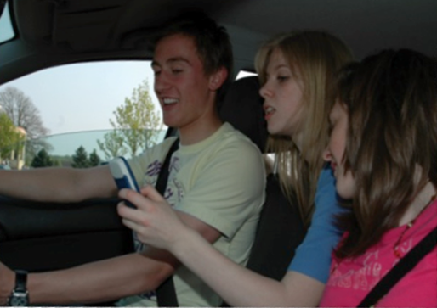
Distractions for drivers
Listening to loud music
Using mobile phone / texting
Peer pressure / inattentive driving

Slide 16
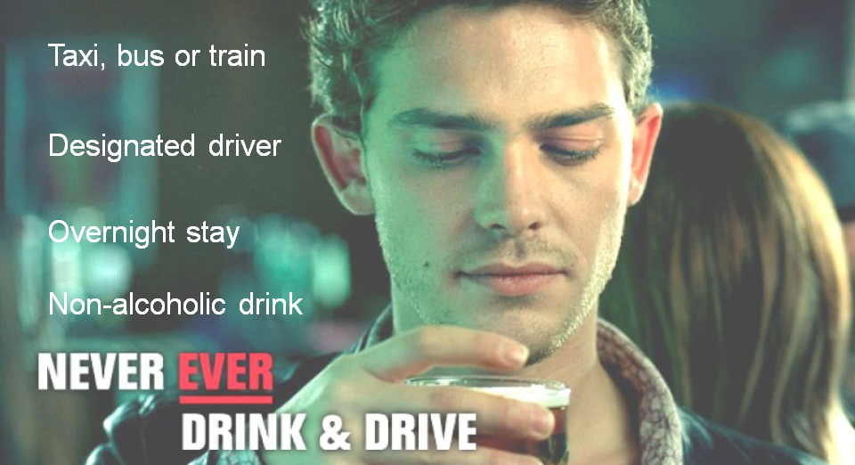
You don’t have to mix drinking and driving
Notes:
Slide 16
YOU DON’T HAVE TO MIX DRINKING AND DRIVING
This slide will let the teacher discuss with the students how best to plan their journey home after a night out.
Big night out so where are we going? What are you going to wear? How much money do you need? Have you charged you phone?
HAVE YOU PLANNED HOW YOU ARE GETTING HOME?
This is something that most people don’t often plan in advance. If you find yourself at the end of the night with no lift home what would you do?
You have a number of options:
Public transport
Taxi
Have a designated driver
Lift
Overnight stay
Ring your parents/guardian
Public transport might not be an option as buses and trains in Northern Ireland generally stop long before clubs close.
Taxis – It would be advisable to book a taxi in advance of going out as they may not be available when you need one.
If you are offered a lift from someone you meet in the club there are a number of things you need to consider.
Safety – how well do you know the person?
Have they been drinking or taking drugs?
You may have planned an overnight stay with a friend but remember you still need to plan how to get there.
A good plan would be to have a designated driver. This is when someone takes responsibility to drive everyone home. That person should not drink anything with alcoholic content.
If you plan an overnight stay and intend driving home the next morning:
REMEMBER the rules
You may still be over the legal limit the morning after the night before.
Don’t be afraid to ring your parents/guardian to get you home. They may be cross at 3am in the morning but they will get over it and will be happy that you are safe.
NEVER EVER DRINK AND DRIVE

Slide 17
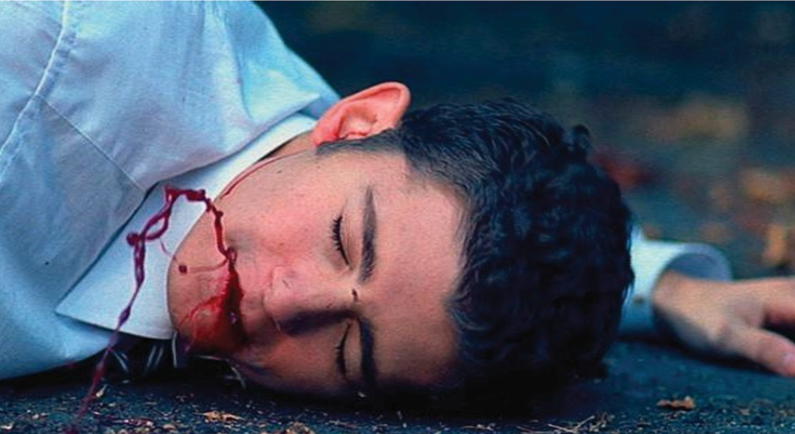
Could YOU live with the SHAME?
Your decisions have a major impact!
Notes:
Slide 17
YOUR DECISIONS HAVE AN IMPACT
The teacher can use this final slide to summarise the drink drive message.
The emphasis should be on ‘Could you live with the shame?’
How would it impact on your life and others if you killed another person through your selfish, stupid behaviour? Could you cope with prison? How would it affect your chances of employment?
Would you be accepted in your community?
REMEMBER WHEN IT COMES TO ROAD SAFETY EVERY ACTION HAS A CONSEQUENCE AND COULD BE A MATTER OF LIFE OR DEATH.

