Slide 1
Distractions for Road Users
Notes:
A distraction is “something that diverts the attention”.
Students should:
consider how distractions increase risks for all road users;
identify what they need to pay attention to, in order to stay safer as a pedestrian, cyclist or driver (when they are able to drive legally);
identify things that may distract them when using the road;
identify things that may distract drivers, preventing them from seeing pedestrians and cyclists; and
learn how they can avoid distractions to stay safer.

Slide 2
Pre-Evaluation- Distractions
 | Strongly Agree | Agree | Don't Mind | Disagree | Strongly Disagree
I have recently read ‘The Highway Code.’
Pedestrians and cyclists do not need to read ‘The Highway Code’.
Knowledge of ‘The Highway Code’ is essential to safe driving.
I know the meaning of most road signs.
‘The Highway Code’ is an important part of The Driving Test.
Notes:
Teachers should complete the pre-evaluation before watching the video. This is located at Annex A in the teaching notes.
Please complete by asking your class the questions- this could be answered by a show of hands. Please tick one answer box per question.
If teachers could complete a hard copy of this and then return to Road Safety Promotion and Outreach Branch, Room G-31, Clarence Court, 10-18 Adelaide Street, Belfast, BT2 8GB or email to safeandsustainabletravel@infrastructure-ni.gov.uk

Slide 3
Video

Slide 4
Discussion
Who was at fault?
Should he have been using his mobile phone?
What could he have done differently?
What are the consequences for all involved?
Notes:
Discuss the DVD, there may be a number of opinions and views. The most obvious opinion may be the boy was responsible because he was using his mobile while driving. There are no right or wrong answers as they all contributed to the tragic outcome.
He should not have been using the phone while driving his car. Advise your students that no text or call is that important. If you have to take a call or make a text you should ensure that you are not in danger i.e. not near a road or crossing a road.
Emphasise that the outcome could have been very different had he not checked his mobile while driving. He should have waited until he had parked the car or pulled over to somewhere safe. He should have concentrated more on his surroundings and not let himself be distracted by the message.
Point out that all actions have consequences- think before you act. Discuss what effect this incident would have on all concerned. The driver will be affected by shock and will have to live with the aftermath of the tragedy, he may also face prosecution. The family will have to deal with the heartache and the fact that their daughter will no longer be in their lives. The mother may have to deal with caring for her husband for the rest of his life, while coping with the loss of her daughter.
All this because of a text message. THAT TEXT CAN WAIT!!!

Slide 5
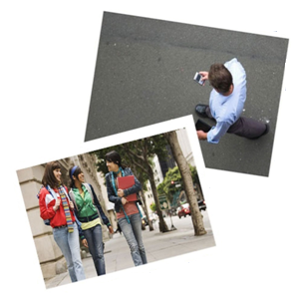
Pedestrian Distractions
Headphones
Friends
Your mood
Can you think of any others?
Notes:
Headphones: Lots of people enjoy listening to music while out and about. Without spoiling anyone's enjoyment of listening to their favourite tracks it must be pointed out that this can be a distraction while on or close to a road. It is possible that someone may get so engrossed in their music that they do not pay attention to their surroundings especially when crossing the road. Advise your students that they should remove their headphones when attempting to cross the road, the reason for this being they need all their senses to negotiate the traffic. Just being able to see is not enough, it is important that you can also hear the traffic.
Friends: Peer pressure often plays a large part in collisions involving pedestrians. How often do you see a group of school children messing around near a busy road? Roads are not places to play or mess around on. Children should be particularly careful when waiting at bus stops. Quite often they can be seen pushing and messing around although it may not be intentional it is possible for someone to end up being knocked into the oncoming traffic resulting in serious consequences.
Moods: Sometimes how you feel can affect your judgement and decision making. If you are angry, upset or maybe excited it may affect the way you behave while on the road. For example the boy in the DVD was excited about meeting his girlfriend and didn’t take account of his surroundings.
Other: Ask the students if they can think of any other examples of distractions – they may come up with weather conditions, animals, parked cars on pavement, billboards etc .

Slide 6
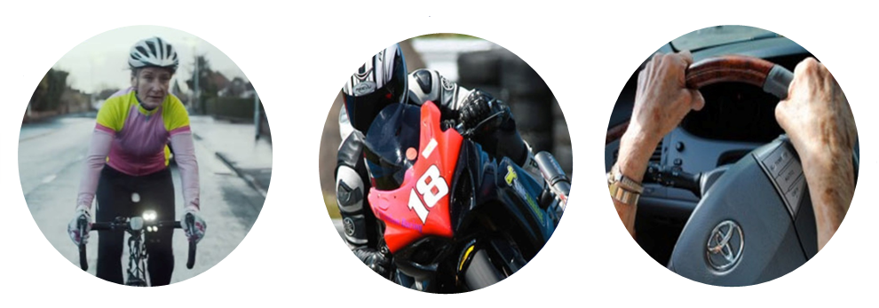
Other Road Users
What other road users may be distracted?
Cyclists
Motorcyclists
Drivers
Notes:
Discuss how drivers may be distracted - some examples may include:
Passenger distraction – everyone is probably guilty of distracting the driver at some stage should it be by talking, showing them a picture, map reading, children crying or fighting with siblings and also pets in the car can all be distractions.
Driver using mobile phone – the danger of this speaks for itself. As well as receiving penalty points and a fine, the driver may be imprisoned if as a result they cause serious injury or death.
Adjusting radio channel – again the driver will not be paying attention to the road and could cause a collision. It only takes a split second of inattention for an incident to occur.
The following distractions apply not only to car drivers but to cyclists and motorcyclists:
Billboards – They are there to catch your attention but if a driver, cyclist or motorcyclist diverts their attention to read the sign this may cause a collision.
Shops – Distractions may be caused by drivers looking in shop windows – women in particular may be distracted by shoes and handbags whereas men may be attracted to car showrooms.
Pedestrians - the behaviour of pedestrians can be a distraction for drivers i.e. if a pedestrian walks straight out into the path of the driver without looking. Your students may also suggest that a distraction may be members of the opposite sex.
Other drivers – road rage including drivers pulling out without looking or indicating, tailgating, driving too close when overtaking, unsafe overtaking and rude gestures.

Slide 7
Pay Attention or Pay the Price

Slide 8
Video
Notes:
This video clip is not intended to be shown to persons below the age of 15 years.
Before you show the advert, tell students that you're going to listen to excuses that people gave when they were involved in a road traffic collision. Think about why drivers need to concentrate, and not be distracted when they're using the roads.

Slide 9
Post Evaluation- Distractions
 | Strongly Agree | Agree | Don't Mind | Disagree | Strongly Disagree
I have recently read ‘The Highway Code.’
Pedestrians and cyclists do not need to read ‘The Highway Code’.
Knowledge of ‘The Highway Code’ is essential to safe driving.
I know the meaning of most road signs.
‘The Highway Code’ is an important part of The Driving Test.
Notes:
Teachers should complete the post-evaluation at the end of the presentation. This is located at Annex B in the teaching notes.
Please complete by asking your class the questions- this could be answered by a show of hands. Please tick one answer box per question.
If teachers could complete a hard copy of this and then return to Road Safety Promotion and Outreach Branch, Room G-31, Clarence Court, 10-18 Adelaide Street, Belfast, BT2 8GB or email to safeandsustainabletravel@infrastructure-ni.gov.uk

