Slide 1
Alcohol, Drugs and the Road User
Notes:
Teacher’s Notes
Drugs and alcohol are responsible for a high number of road traffic collisions in Northern Ireland causing death or serious injury.
Students should:
Consider how drugs and alcohol increase risks for all road users.
Learn that even one drink affects you as a road user. (pedestrians, cyclists and drivers/passengers).
Know how alcohol is measured in units and the effects it has on the body and how long it takes to leave your system.
Be aware how illegal drugs affect you as a road user.
Consider the implications of taking alcohol and or drugs as a road user and the effect it may have on them and others.
Understand that their decisions have a major impact. Could you live with the shame?

Slide 2
Pre-Evaluation – Alcohol and Drugs
 | Strongly Agree | Agree | Don't Mind | Disagree | Strongly Disagree
Never ever drink and drive.
It is safe to drive while taking prescription drugs.
It is fine to take a lift from someone who has been drinking alcohol.
Two pints of beer will not put you over the legal limit.
Coffee or greasy food will help me to sober up more quickly.
Notes:
Teachers should complete the pre-evaluation before watching the video. This is located at Annex A in the teaching notes.
Please complete by asking your class the questions- this could be answered by a show of hands. Please tick one answer box per question.
If teachers could complete a hard copy of this and then return to Road Safety Promotion and Outreach Branch, Room G-31, Clarence Court, 10-18 Adelaide Street, Belfast, BT2 8GB or email to safeandsustainabletravel@infrastructure-ni.gov.uk

Slide 3
Video
Notes:
Teacher’s Notes
Please be aware that this advert has been designed to be viewed by persons over 15 years of age.
Before you show the advert, tell students that they should think about why pedestrians and drivers need to be aware of the dangers of using drugs and alcohol as a road user.

Slide 4
Discussion
Who was at fault?
What could he have done differently?
What are the consequences for all involved?
Notes:
Teacher’s Notes
Discuss the DVD, there may be a number of opinions and views. The most obvious opinion may be that the guy was responsible because he was drinking and chose to drive. Others may blame peer pressure as his friends encouraged him to stay and have another. Some may be of the opinion that the bar staff had a responsibility not to serve any more alcohol if they know a person is about to drive.
The short answer is NO. You should advise your students that even one drink is too many. Although there are legal limits the best decision to take is not to drink at all. (We will look at legal limits and units of alcohol later in the presentation).
He could have arranged a lift, ordered a taxi or travelled with someone who was not drinking. He had a choice and he made a bad decision with dire consequences when he drank alcohol and drove his car.
His family and his friends families will have to live with the loss of their son/brother/grandson and deal with the trauma. Their children were robbed of a future, this was not an accident it could have been prevented.
NEVER EVER DRINK AND DRIVE

Slide 5
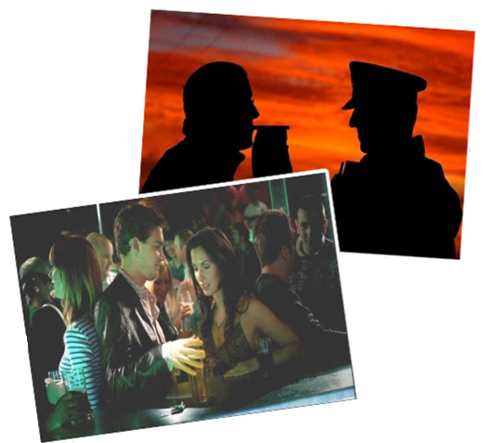
The Effects of Alcohol
Impairs the Brain
Affects your Judgement
Takes effect Quickly
Wears off Slowly
Notes:
Teacher’s Notes
Talk to your students as to how alcohol and drugs will affect their personality, judgement, reaction times and perception of risk.
How does alcohol and drugs affect them?
You may get responses such as: happy, depressed, anxious, gives them confidence, emotional etc
On the road alcohol is one of the leading causes of collisions, leading to many deaths and serious injuries. It may be down to a driver who has chosen to drink and drive or it may be a pedestrian who has taken drugs causing their thinking process to be effected, putting themselves and others in danger.
For further information on the current legal alcohol limit for driving see www.psni.police.uk

Slide 6
Timeline
12.00am – You have consumed approx 8 pints of beer (Approx 16 units)
7.30am – On waking up there will still be alcohol in your system and you will be unfit to drive
12.00pm – Although alcohol continues to leave your body, you may still be over the legal limit
4.00pm – It has now been 16 hours since you have consumed alcohol and it is only now that it may be eliminated from your system
Notes:
Teacher’s Notes
Discuss with your students how alcohol enters the blood stream very quickly but takes longer to leave the system. You may take the opportunity to highlight how their perceptions, attitudes and judgements may be affected after drinking.
Any amount of alcohol affects your judgement to risk taking should you be driving, crossing the road, or indeed cycling.
Even after one drink you will be less alert, have trouble judging speed and distance and reaction times will be slower.
It is a myth that having coffee, a shower, sleeping or eating greasy food will speed up alcohol elimination. Nothing will speed up the process it just takes time.
THE ONLY SAFE COURSE IS NOT TO DRINK AND DRIVE

Slide 7
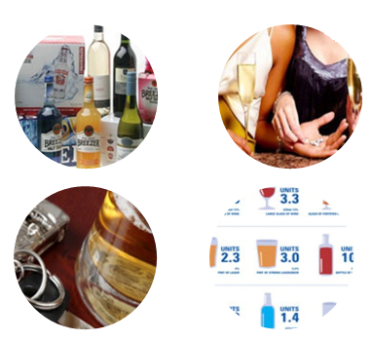
Know your Units
A small shot of spirits = 1 unit
Alco pops = 1.5 units
Pint of beer/lager = 2 units
Large glass of wine = 3 units
Notes:
Teacher’s Notes
Ask your students is there a safe limit to drink and drive?
Suggestions may include one pint, two pints etc. Research shows that even after one alcoholic drink peoples’ reaction times, ability to cope with real time issues and assessment of risk are affected.
Explain that all alcoholic drinks have different strengths for example beer – there is a huge difference between the strength of a pint of Harp Lager and a pint of Carlsberg Special which students may not have considered.
THERE IS NO SAFE LIMIT – ONE DRINK IS ONE TOO MANY
For further information on the current legal alcohol limit for driving see www.psni.police.uk

Slide 8
Illegal Drugs
Cannabis stays in your system for up to 6 weeks
Cocaine stays in your system for up to 3 days
Amphetamine substances (speed) stay in your system for up to 4 days
Notes:
Teacher’s Notes
Taking drugs can put you at greater risk on the road as a pedestrian, driver or passenger. Drugs can change your awareness of risk and make you behave dangerously putting yourself and others at risk of injury and death.
Drugs can be broadly divided into three categories based on their main effects. They may act solely as stimulants, depressants or hallucinogens. Quite a few drugs show two of these effects at the same time.
Stimulants make you feel like you have lots of energy and confidence. They include cocaine, speed, ecstasy and mephedrone.
Depressants make you feel relaxed and chilled out. They include alcohol, tranquillisers, heroin and cannabis.
Hallucinogens can make you view reality in distorted ways and sometimes cause vivid hallucinations. They include LSD and magic mushrooms.
In addition to these 3 broad categories, each particular drug has its own specific effects and risks.
Even some prescription drugs can be dangerous to the road user.

Slide 9
Post-Evaluation – Alcohol and Drugs
 | Strongly Agree | Agree | Don't Mind | Disagree | Strongly Disagree
Never ever drink and drive.
It is safe to drive while taking prescription drugs.
It is fine to take a lift from someone who has been drinking alcohol.
Two pints of beer will not put you over the legal limit.
Coffee or greasy food will help me to sober up more quickly.
Notes:
Teachers should complete the post-evaluation at the end of the presentation. This is located at Annex B in the teaching notes.
Please complete by asking your class the questions- this could be answered by a show of hands. Please tick one answer box per question.
If teachers could complete a hard copy of this and then return to Road Safety Promotion and Outreach Branch, Room G-31, Clarence Court, 10-18 Adelaide Street, Belfast, BT2 8GB or email to safeandsustainabletravel@infrastructure-ni.gov.uk

